Slide 1
Code analyze my SQL code and schema with .NET
@ErikEJ

Slide 2
Why fun? Why profit?
Fun is learning new things that add value
Profit is shifting left
Shifting left is expert help with database design

Slide 3
Demo!

Slide 4
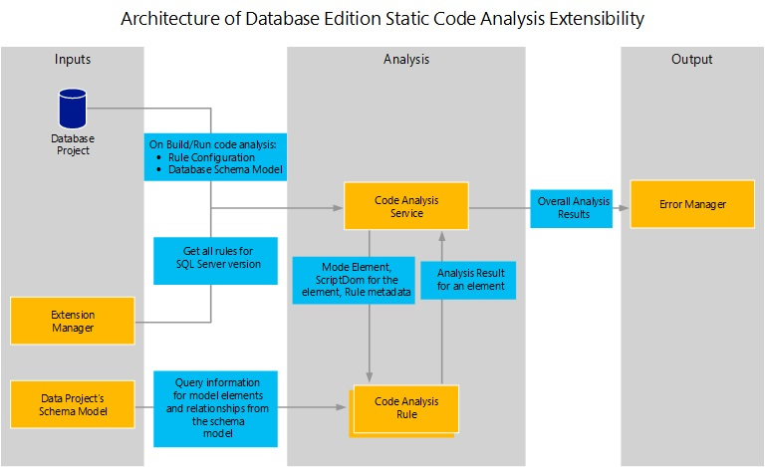

Slide 5
Demo!

Slide 6
Database project / MSBuild.SDK.SqlProj
 | .SQLPROJ (DB project) | MSBuild.SDK.SqlProj
Create a .dacpac | ✔ | ✔
Run Code Analysis | ✔ (15 rules) | ✔ (50+ rules)
Run custom rules | ✔ (admin access) | ✔
Run rules on hosted agent | ✔ | ✔
Run custom rules on hosted agent | ❌ | ✔
Build on Linux (dotnet build) | ❌ | ✔
Visual designers | ✔ | ❌

Slide 7

CTA
Add you database schema to source control
Enable code analysis locally and in CI
Optional: Create your own rules and contribute them back to the community
Q & A

Slide 8
What is a dacpac and why should I care?

Slide 9
Why?
Data Tier Application Package
Get your database under source control
Ensure your .sql scripts ”build” – code validation
Ensure your .sql scripts follow business rules – code analysis
Deploy changes to the database schema with changes to your app
No more migration scripts – simply describe your desired state
Cross platform build and deployment support

Slide 10
Process
Create / import .sql scripts
Build
.dacpac
Deploy
Create SQL project

Slide 11
Tooling
Create / import .sql scripts
Build
.dacpac
Deploy
Create SQL project
Visual Studio
VS Code
sqlpackage extract
dotnet new
Azure DevOps pipelines
GitHub actions
sqlpackage publish
MSBuild
dotnet build
dotnet pack

Slide 12

Process
Create .sql scripts
Build
.dacpac
Deploy
Create .sqlproj

Slide 13

Why .dacpac?
Ensure high quality and consistent SQL schema
Enforce design and security rules
Desired state configuration
Publish magic!

